Slide 1

Berkarir di Cyber security
Satria Ady Pradana

Slide 2
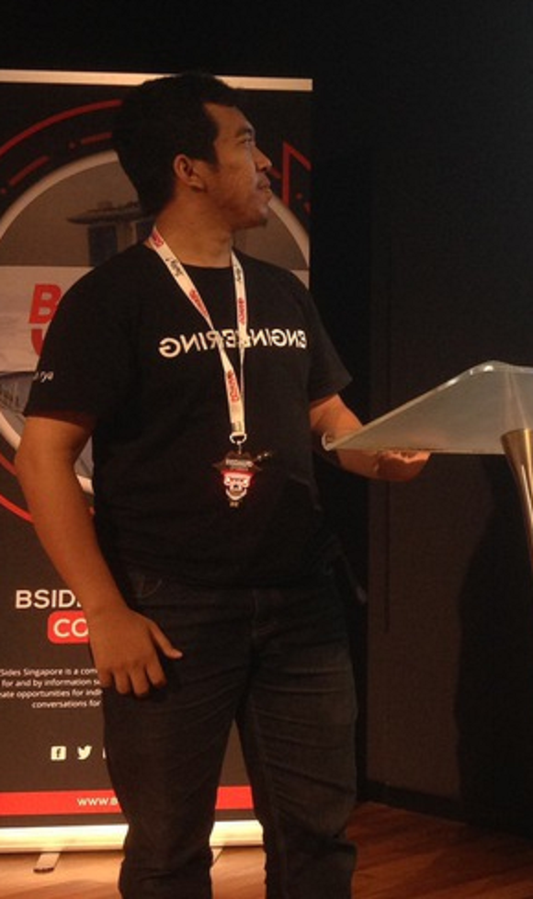



Who?
Satria Ady Pradana
Cyber Security Consultant at Mitra Integrasi Informatika
Co-Founder of Archonlabs SSD
Penetration Tester, Red Team
Community Leader of Reversing.ID
@xathrya
xathrya
xathrya_

Slide 3
Become professional
Red Team

Slide 4
(Cyber) security professional
(n) Professional who is hired to keep online information of all sorts protected from cyber attacks and other malevolent threats.
Security is hot field in Indonesia.
Rapidly growing in demand for qualified people.

Slide 5
AS RED TEAM
Red Team: Offensive, Attack, Pillage
Ensuring the security by attacking assessing it.
Proving the system is secure/insecure
In general, they do:
Discover vulnerabilities of the system.
Planning and executing attack.
Create proof of concept.
Create mitigation/fixing recommendation.

Slide 6


Concern of security
Designing
Testing
Monitoring
Code / Program
Infrastructure

Slide 7
Exploring the jobs
Penetration Testing
Exploit Research
Vulnerability Assessment
Adversary Simulation/Emulation
No DoS or DDoS!

Slide 8
Challenges
Must follow security trends, discoveries, and techniques.
CVEs
Security bulletins
Security incidents
Specialization
Simplify the problem so even non-technical people understand.

Slide 9
SPECIALIZATION (Topics)
Application
Web
Android
Mobile
Service
iOS
Active Directory
Infrastructure
Container
Network
IoT
AWS
GCP
Cloud
Azure
Smart Contract

Slide 10
Getting started as red team
Preparation?
Lab & Exercise?
Community?
Certification?

Slide 11
Skill set
Computing
Operating system
Virtual Machine
Containers
Networking
Client-Server Model
TCP/IP
Network Segment
Firewall
VPN
Web Technology
Request & Response
Programming
Algorithm
Problem Solving
Storage & Database

Slide 12
Lab & exercise
Pentest Lab
Vulnhub (https://www.vulnhub.com)
Vulhub (https://github.com/vulhub/vulhub)
https://medium.com/mii-cybersec/improving-pentesting-skill-with-intentionally-vulnerable-apps-ece1cdf3dc63
https://www.amanhardikar.com/mindmaps/Practice.html
Challenges & CTF Lab
HackTheBox (https://hackthebox.eu)
TryHackMe (https://tryhackme.com)
Pentestit.ru (https://lab.pentestit.ru)
AttackDefense (https://attackdefense.pentesteracademy.com)

Slide 13
Associate
Join community (telegram / whatsapp / slack)
Pentester ID (telegram)
ECHO (telegram)
Jasakom Perjuangan (telegram)
Cyber Army (telegram)
Join Bug Hunting Platform: Cyber Army, Red Storm, HackerOne, BugCrowd, Synack,
Write and publish research as blog post, paper, article, etc.
Attending conference, seminar, workshop, training in cyber security.

Slide 14
Should I Certified?
Benefit
Help employers evaluate potential new hires.
Recognition of competency.
Recommendation:
OSCP (Offensive Security Certified Professional)
eJPT (eLearnSecurity Junior Penetration Tester)
CEH (Certified Ethical Hacker)
PNPT (Practical Network Penetration Tester)

Slide 15


Slide 16
Thank You
Satria Ady Pradana
spradana [at] archonlabs.id
@xathrya (telegram)

